Slide 1
iGCSE chemistry
ALKANE
MD KAMRUL ALAM KHAN

Slide 2
Content
Organic Chemistry
Introduction
Alkanes

Slide 3
Introduction
Alkanes
Introduction
1 explain the terms homologous series, hydrocarbon, saturated, unsaturated, general formula and isomerism.
b) Alkanes
2 recall that alkanes have the general formula C_{n}H_{2n+2}
3 draw displayed formulae for alkanes with up to five carbon atoms in a molecule, and name the straight-chain isomers
4 recall the products of the complete and incomplete combustion of alkanes
5 describe the substitution reaction of methane with bromine to form bromomethane in the presence of UV light.

Slide 4

Organic Chemistry
What is Organic Chemistry?

Slide 5

Organic Chemistry
What is Organic Chemistry?
It’s the chemistry of carbon-containing compounds

Slide 6
Organic Chemistry
What is Organic Chemistry?
It’s the chemistry of carbon-containing compounds
Most of these compounds also contain hydrogen, and many also contain oxygen or other elements.

Slide 7
Organic Chemistry
Many organic compounds occur naturally, and many others are made by man.

Slide 8
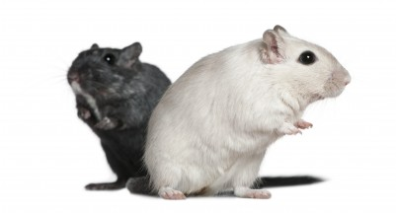
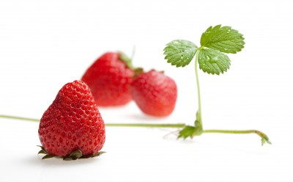
Organic Chemistry
Many organic compounds occur naturally, and many others are made by man.
All living things contain organic compounds

Slide 9
Organic Chemistry
Natural | Man-made
Sugars Methane (natural gas) Proteins, fats | Ethene Ethane Polymers, such as polythene

Slide 10
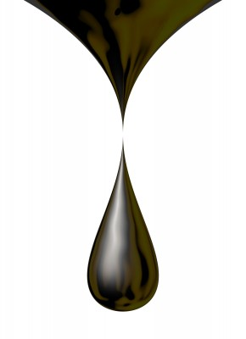
Organic Chemistry
Crude oil is a mixture of organic compounds. It is the raw material used for the manufacture of plastics, solvents, and thousands of organic chemicals.

Slide 11
Organic Chemistry
Upper layers
Rock
Shale
Natural gas
Crude oil
Rock

Slide 12
Organic Chemistry
Crude oil (petroleum) was formed millions of years ago by the decomposition of animals and plants under pressure.
Upper layers
Rock
Shale
Natural gas
Crude oil
Rock

Slide 13
Organic Chemistry
Crude oil is a dark viscous liquid mixture of many different hydrocarbons.
Upper layers
Rock
Shale
Natural gas
Crude oil
Rock

Slide 14

Organic Chemistry
Crude oil is a dark viscous liquid mixture of many different hydrocarbons.
Upper layers
Rock
Shale
Viscous = does not flow easily.
Natural gas
Crude oil
Rock

Slide 15
Organic Chemistry
Crude oil is a dark viscous liquid mixture of many different hydrocarbons.
Upper layers
Rock
Shale
Hydrocarbon = compound containing hydrogen and carbon only
Natural gas
Crude oil
Rock

Slide 16

Organic Chemistry
The LARGER the hydrocarbon
i.e. the greater the number of carbon atoms in a molecule:
The less easily it flows (i.e. the more viscous it is)
The less easily it ignites (i.e. the less flammable it is)
The less volatile it is (i.e. it doesn’t vaporise as easily)
The higher its boiling point.
Hydrocarbon = compound containing hydrogen and carbon only

Slide 17
Organic Chemistry
Crude oil is the major source of energy in most industrial countries. Over 90% is used as a fuel in industry or transport.
Upper layers
Rock
Shale
Natural gas
Crude oil
Rock

Slide 18
There are three stages in the refining of crude oil.

Slide 19
There are three stages in the refining of crude oil.
Fractional distillation

Slide 20
There are three stages in the refining of crude oil.
Fractional distillation
Cracking

Slide 21
There are three stages in the refining of crude oil.
Fractional distillation
Cracking
Reforming

Slide 22
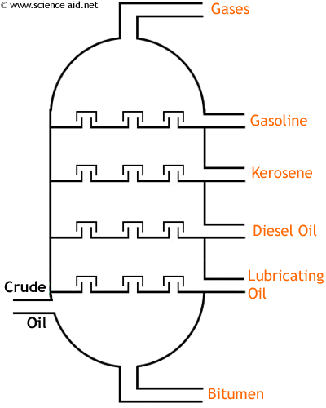
Fractional distillation
Crude oil is heated and passed into a tall fractionating column

Slide 23
Fractional distillation
Hydrocarbons with the lowest boiling points (gases) pass to the top of the column.

Slide 24
Fractional distillation
Hydrocarbons with the highest boiling points collect at the bottom of the column.

Slide 25
Fractional distillation
Intermediate fractions are also collected

Slide 26
Fractional distillation
The various fractions are purified and blended to use as petrol, solvents, and heating and diesel oils.

Slide 27
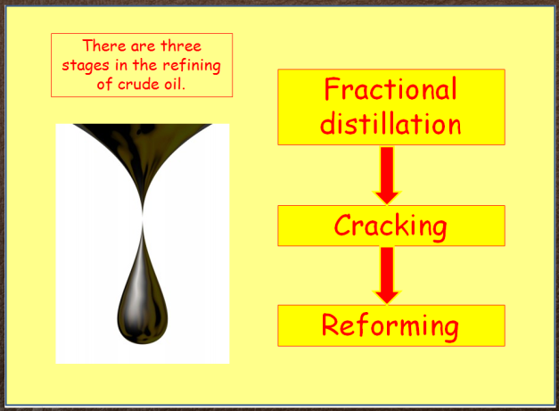
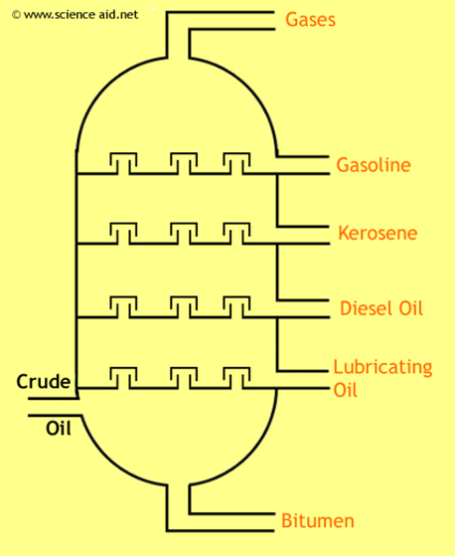
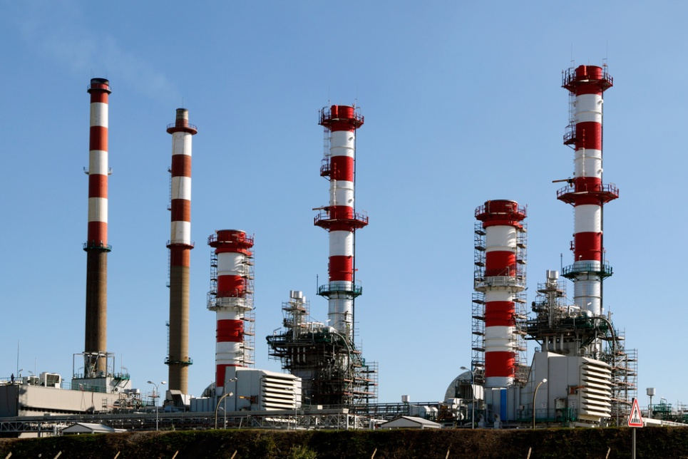
Cracking
There is less demand for the thicker oils (oils with higher relative molecular masses and higher boiling points). The thicker oils are therefore often ‘cracked’.

Slide 28
Cracking
There is less demand for the thicker oils (oils with higher relative molecular masses and higher boiling points). The thicker oils are therefore often ‘cracked’.
This means that the larger molecules are broken down into smaller ones suitable for making petrol. This can be done in 2 ways.

Slide 29
Cracking
There is less demand for the thicker oils (oils with higher relative molecular masses and higher boiling points). The thicker oils are therefore often ‘cracked’.
This means that the larger molecules are broken down into smaller ones suitable for making petrol. This can be done in 2 ways.
Thermal cracking – using heat
Catalytic cracking – using heat and a catalyst

Slide 30
Reforming
In reforming, hydrocarbons with small chains of carbon atoms are converted to hydrocarbons consisting of larger molecules.

Slide 31
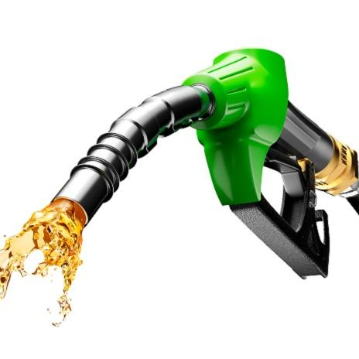
Alkanes
The simplest of all hydrocarbons

Slide 32
Alkanes
The simplest of all hydrocarbons
X
X
C
C
X
X
X
X
Carbon 2:4 Forms four covalent bonds

Slide 33
Alkanes
Alkanes
H
C
H
H
H

Slide 34
Alkanes
Alkanes
H
CH₄
C
H
H
Methane
H
Four single
C-H bonds

Slide 35
Alkanes
Alkanes
H
CH₄
C
H
H
Methane
H
Four single
C-H bonds
Alkanes are saturated hydrocarbons. All bonds are occupied.

Slide 36
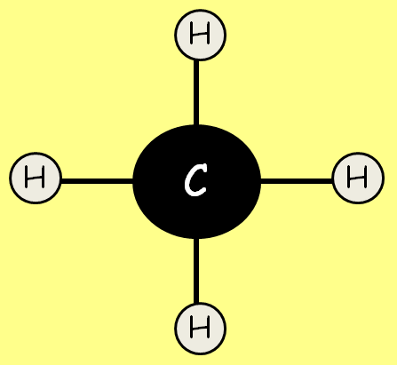
Alkanes
Name | Molecular formula | Physical state
Methane | CH₄ | Gas
Ethane | C₂H₆ | Gas
Propane | C₃H₈ | Gas
Butane | C₄H₁₀ | Gas
Pentane | C₅H₁₂ | Gas
Hexane | C₆H₁₄ | Liquid

Slide 37
Alkanes
Name | Molecular formula | Physical state
Methane | CH₄ | Gas
Ethane | C₂H₆ | Gas
Propane | C₃H₈ | Gas
Butane | C₄H₁₀ | Gas
Pentane | C₅H₁₂ | Gas
Hexane | C₆H₁₄ | Liquid
The Alkanes form an homologous series.
Each member differs from the next by the unit –CH₂

Slide 38
Alkanes
Name | Molecular formula | Physical state
Methane | CH₄ | Gas
Ethane | C₂H₆ | Gas
Propane | C₃H₈ | Gas
Butane | C₄H₁₀ | Gas
Pentane | C₅H₁₂ | Gas
Hexane | C₆H₁₄ | Liquid
The homologous series of alkanes has the general formula:
C_{n}H_{2n+2}

Slide 39
Alkanes
H
H
H
H
C
H
H
C
C
H
Ethane
H
H
H
Methane
H
H
H
H
C
C
C
H
H
H
H
Propane

Slide 40
Alkanes
H
H
H
H
Butane
H
C
C
C
C
H
H
H
H
H
H
H
H
H
H
Pentane
H
C
C
C
C
C
H
H
H
H
H
H

Slide 41
Alkanes and Isomerism
Compounds exhibit isomerism when they have the same molecular formula but different structural formulae.
All alkanes with more that three carbon atoms have more than one structure.

Slide 42
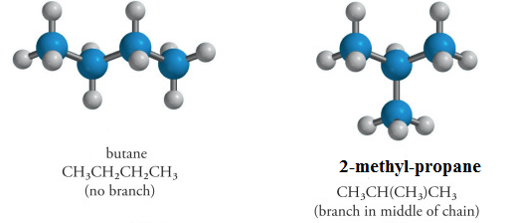
Alkanes and Isomerism
H
H
H
H
Butane, C₄H₁₀
H
C
C
C
C
H
H
H
H
H
H
H
H
H
C
C
C
H
2-Methylpropane, C₄H₁₀
H
H
H
C
H
H

Slide 43
Combustion of Alkanes
Alkanes burn in plentiful air to form carbon dioxide and water:
Eg: Methane + Oxygen → Carbon dioxide + water
CH₄(g) + 2O₂(g) → CO₂(g) + 2H₂O(g)
This is known as complete combustion.

Slide 44
Combustion of Alkanes
Alkanes burn in limited air to form carbon monoxide and water:
Eg: Methane + Oxygen → Carbon monoxide + water
2CH₄(g) + 3O₂(g) → 2CO(g) + 4H₂O(g)
This is known as incomplete combustion.

Slide 45
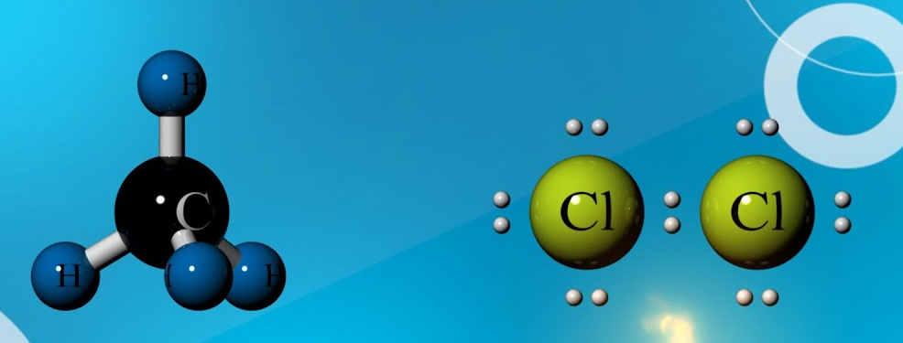
Alkanes and substitution reactions

Slide 46
Alkanes and substitution reactions
Alkanes, as saturated compounds, can react by substitution. For example, when a mixture of methane and bromine is exposed to ultraviolet light – typically sunlight – a substitution reaction occurs, and the organic product is bromomethane.
CH₄ + Br₂ → CH₃Br + HBr
methane bromine bromomethane hydrogen
bromide

Slide 47
Alkanes and substitution reactions
One hydrogen atom of the methane molecule is substituted by a bromine atom
H
H
H
C
H
+
Br Br →
H
C
Br + H Br
H
H

Slide 48
End of Section
In this lesson I have covered:
Introduction to Organic Chemistry
The Chemistry of Alkanes

Slide 49
THANKS FOR YOUR KIND ATTENTION
APEIRON
🎓 Excel in IGCSE, A‑Level & IAL with APEIRON
🧪 Chemistry | ⚛️ Physics | 🧬 Biology | 💻 ICT | 📐 Mathematics | 📖 English
✅ Edexcel & Cambridge (CIE) exam boards
📚 Free digital library (notes, worksheets, past papers)
🔬 Advanced lab facilities for core practicals
👨‍🏫 Expert faculty with years of British curriculum experience
Call to Action:
📞 Call / WhatsApp: +8801557704046, +8801719014276
🌐 Website: https://apeironlab.science
📧 Email: info@apeironlab.science

